Slide 1
Contentious Origins of Social Protection: China’s “Treat-driven” Redistribution
Hongshen Zhu
Global China Postdoctoral Fellow
East Asia Center, University of Virginia

Slide 2
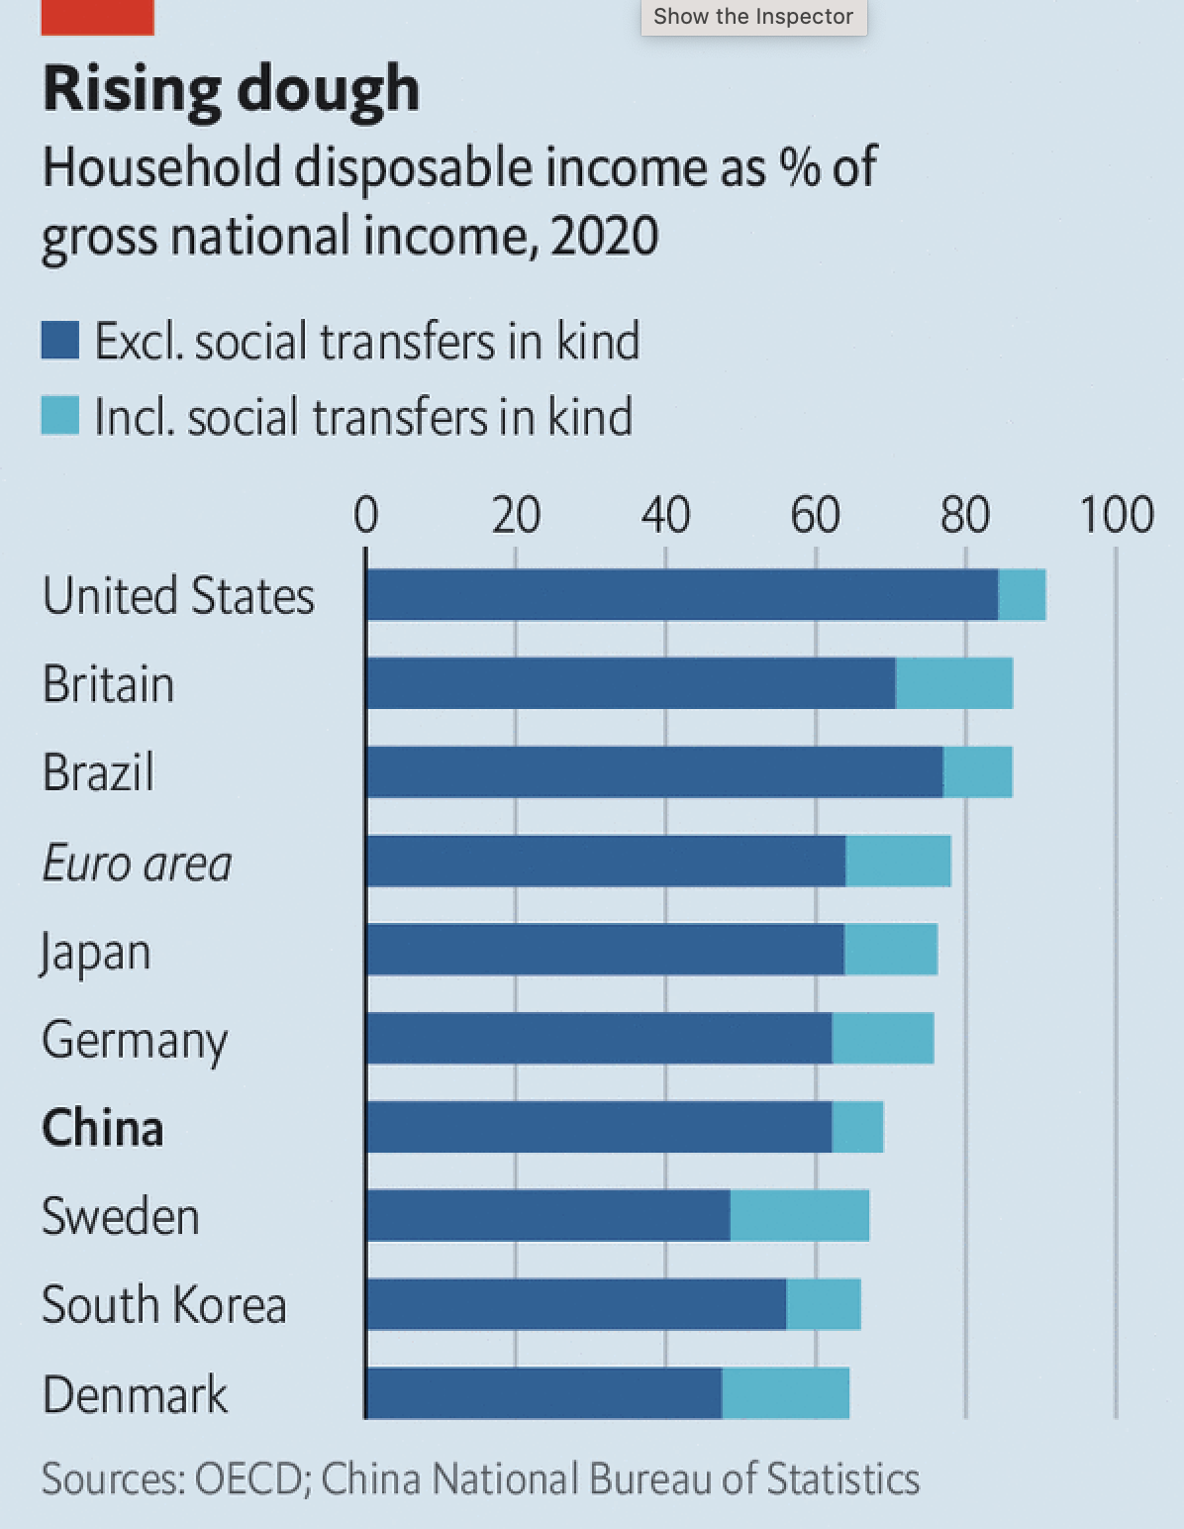
Motivation
China’s imbalance between savings and consumption
Social Transfer in Kind (healthcare, social welfare, etc.) below average
Weak social safety net
Notes:
There has been a consensus that China’s economy faces an insufficient internal demand problem. Households save over one third of their income. There are too much savings and too little consumption such that the governments need boost public investment and accumulate debts.
At the same time, we see government spending tilted fell short of welfare transfers to households. Social transfer in kind was still meagre by international standards and households in China still have a relatively weak social safety net.

Slide 3
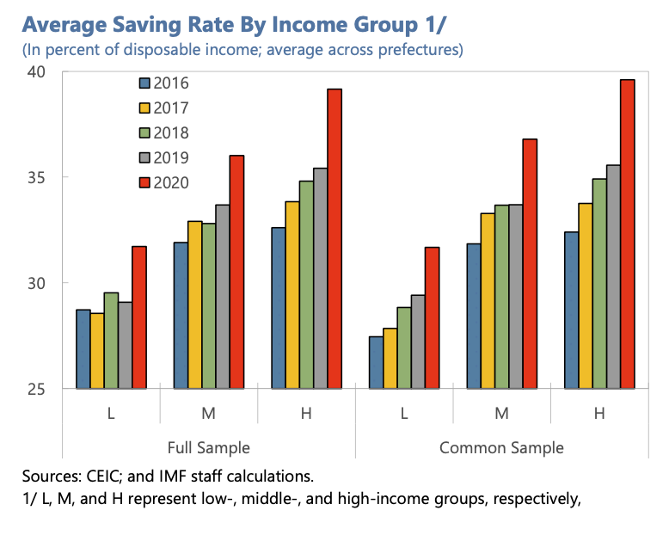
Motivation
High income households save more of their income
Poor households have to save for precautions
Welfare state and redistribution sit at the center of the economic imbalance
What drives China’s welfare state?
Notes:
Looking into saving propensity across income levels, we see poor households in China saving around 30% of their disposable income for precaution while rich households save nearly 40%.
Therefore, welfare state and redistribution stands at the center of the economic imbalance. Because they would both decrease the rich's income share and the poor's precautionary savings.
As in any country, redistribution is a political question that needs a political answer. What exactly motivates the establishment of China’s welfare state in the first place and what drives the welfare state's growth become very important.

Slide 4
Theoretical Puzzle
Electoral democracy provides welfare because median voter poorer than mean income (Meltzer and Richard 1981)
Non-democracies provides welfare for critical supporters (Knutsen and Rasmussen 2018)
China's national welfare state started in 1990s to provide for economic losers and expanding to include majority of the population, albeit low benefits
Notes:
The political economy literature has spilled a lot of inks on why states provide redistribution in general.
A classical hypothesis for electoral democracies is a corollary of median voter theorem: median voter is poorer than average income so they prefers redistribution. Median voter's preference will prevail in electoral democracy.
For non-electoral democracies, they tend to distribute extractions to critical supporters like government employees and the military like Italy under Mousolini and Argentina under Peron.
For China, since its nationalized welfare system started to take off in late 1990s, it has been expanding to include the majority of the population instead of just a subgroup. What is the main driver of this expansion of welfare state and why does it have the feature of "high coverage and low benefits"?

Slide 5
Main Finding
China’s redistribution is threat-driven at the local level such that potential collective action drives redistribution efforts
China’s fiscally constrained local states rely on unfunded entitlements (social security) to appease social unrest such that they need to expand participation and contribution to sustain funding
This leads to a snowballing of China’s welfare state
Notes:
Here is the preview of my talk's main findings.
China’s redistribution is threat-driven at the local level such that potential collective action drives redistribution efforts
China’s fiscally constrained local states rely on unfunded entitlements (social security) over taxation to fund redistribution such that they need to expand participation and contribution to sustain future funding. This leads to a snowballing of China’s welfare state because they need to draw in more contributors to meet the rising expenditure.

Slide 6
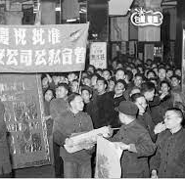
Pre-reform Welfare State
Founding of the Chinese welfare state in the early 1950s
Welfares were largely limited to urban residents
Provided by state-owned enterprises and state-affiliated work units (单位)
Housing, nursery, schooling, hospital, etc. located within compounds (大院)
Notes:
The founding of the Chinese welfare state dated back in the early 1950s.
Welfare benefits were predominantly just accessible to urban residents and were closely tied to employment in state-owned enterprises and state-affiliated work units, known as 单位.
These work units were not just places of employment; they also functioned as the primary providers of social welfare services for their employees.
Essential services such as housing, nurseries, schools, and hospitals were typically situated within large residential compounds, known as 大院. This decentralized but compact nature of social services defined Chinas early welfare state.

Slide 7
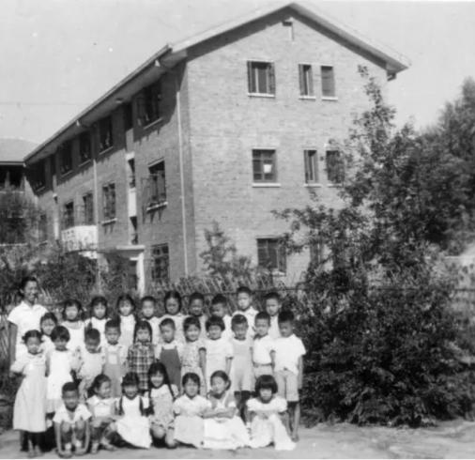
Pre-reform Welfare State
Mini-welfare states in every city
Variations of provisions according to resources of each work unit
Exclusive system: state-affiliated workers only
Local governments: less responsibility of welfare provisions
Notes:
This early system of the Chinese welfare state effectively created mini-welfare states within every city, where each work unit functioned almost as a self-contained community with its own set of social provisions. The range and quality of welfare services varied significantly depending on the resources available to each work unit.
The system was exclusive, catering to only state employees. This exclusivity left the majority of the population, particularly rural residents, without access to similar benefits. Local governments consequently bore less responsibility for welfare provisions, as major welfare responsibilities were decentralized across powerful state-owned enterprises.

Slide 8
SOE Layoffs and Welfare State
Market reforms led to loss-making SOEs and SOE reform in late 1990s
Mini-welfare states sustained by SOEs cannot sustain
Local governments shouldered the burden by taking over SOE welfare
30 Millions SOE workers were laid off in late 1990s
Laid-off workers organized “rightful resistance” against the broken “cradle-to-grave” promise (O’brien & Li 2006)
Notes:
The market reforms initiated in the late 1990s fundamentally altered the economic landscape, particularly for state-owned enterprises.
The old mini-welfare state model proved unsustainable as many SOEs started incurring losses and faced competition from booming private economy.
Consequently, SOE reform became imperative, leading to a shift in the responsibility of welfare provisions from SOEs to local governments.
Thirty million SOE workers were laid off during the reforms and they organized rightful resistance against local governments and SOEs for the broken promise that they'd be taken care of from cradle to grave.

Slide 9
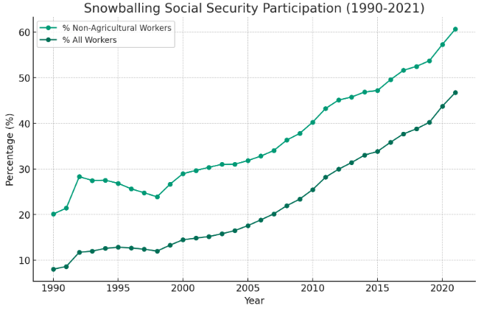
Critical Juncture
1998 SOE reform
Notes:
Here is the participation rate in social security system. Note that it drops to the lowest point in 1998 as the mini-welfare states of SOEs were being dismantled and start to increase ever since.
This makes one wonder “Did the need to appease SOE layoffs kick start this historical turning point for social security participation?”

Slide 10
SOE Layoffs and Welfare State
Pension (1997), healthcare (1998), unemployment insurance (1999)
Unfunded mandates for local governments
Find new revenue sources: social security contribution by new economy
Critical juncture in late 1990s for China’s welfare state
Notes:
From a legislation point, this hypothesis is certainly true. This transition began with the introduction of a pension scheme in 1997, followed by healthcare in 1998, and unemployment insurance in 1999.
Despite these changes, local governments struggled with inadequate fiscal resources to support these welfare programs. After all, SOE were losing money and these workers never contributed to social securities.
The need to identify new revenue streams became evident, and one such solution was to levy social security contributions on the burgeoning new economy.
This paper looks at this critical juncture where SOE layoffs and welfare state coincided and argue that there is a causal relationship here.

Slide 11
Critical Features
Localization
Pay-as-you-go
Political responsibility
Notes:
I want to single out three critical features of China’s social security system that is relevant to my theory
Localization, pay-as-you-go, political responsibility

Slide 12
Localization
County-level government collects social security
Low-level pooling: each county manages their own social security funds that each is only responsible for its own residents
No transfer of surplus across localities
Huge variations on enforcement and mandated rates
Notes:
In China, the administration of social security funds is managed at the county level, with each city overseeing its own resources through a system known as low-level pooling.
In early 2000s, each county had an independent social security fund that each is only responsible for its own residents.
As a result, there are huge variations in enforcement and mandated contribution rates.

Slide 13
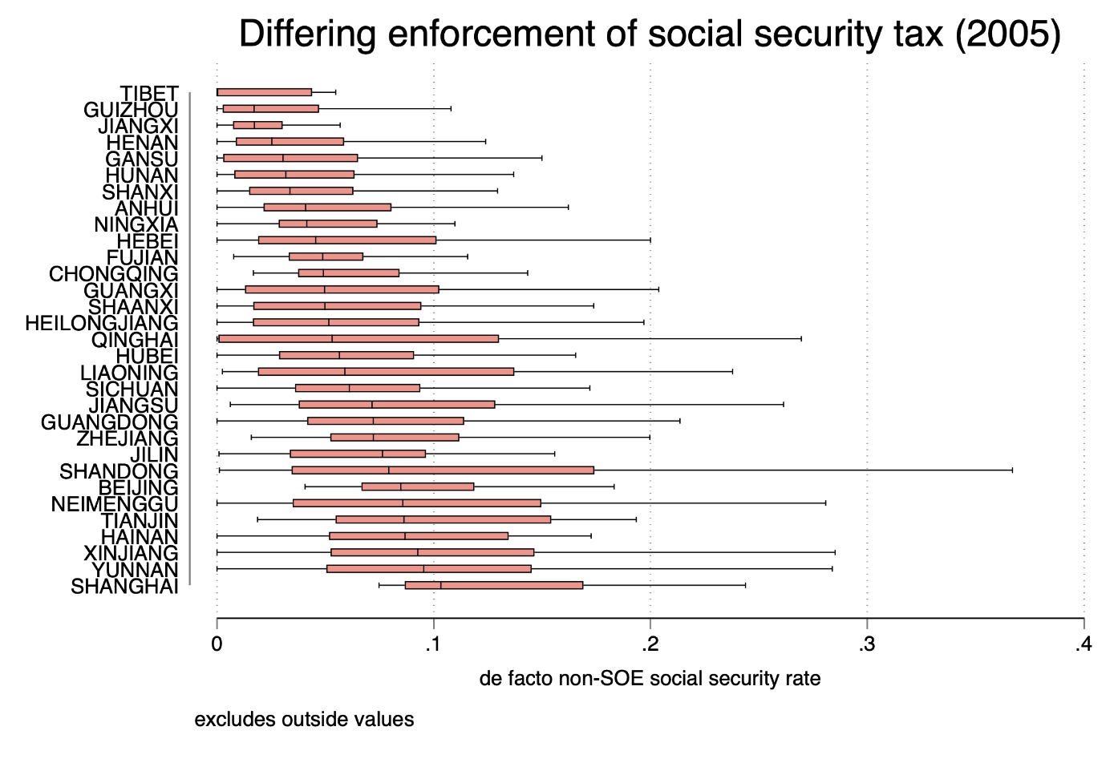
Notes:
Here we see the de facto social security rate in different provinces. Not only the across-provincial differences are significant, the within-provincial differences are even larger. And nearly all of them are blow the national social security rate of 28%.
So we see pervasive forbearance and selective enforcement by local states. What explains these variations?

Slide 14
Pay-As-You-Go
Nominally, China’s social security is a mix of personal accounts and social accounts where some contribution is saved in one’s personal account to pay yourself in the retirement
Effectively the whole system is pay-as-you-go such that no real savings is accumulated
A redistribution from current contributors to current spenders (pensioners)
Notes:
Nominally, China's social security system is structured as a combination of personal and social accounts. This design suggests that a portion of an individual's contributions is allocated to their personal account, supposedly to be saved and used during their retirement years.
However, in practice, the system operates on a pay-as-you-go basis, meaning that no real savings accumulate in these personal accounts.
Effectively, the contributions made by current workers are immediately used to pay out benefits to current retirees. This arrangement does not involve the accumulation of capital to fund future pensions but rather relies on the ongoing contributions of the workforce. As a result, China's social security system functions primarily as a mechanism for redistribution, transferring income from current contributors (workers) to current spenders (pensioners).

Slide 15
Political Responsibility
“Only by establishing a comprehensive social security system and properly addressing [laid-off SOE workers] basic livelihood issues can we prevent shocks to social stability.”
-- Zhu Rongji, Chinese Premier, in 2000
“The prevailing issue stems from a general non-compliance with laws and lenient law enforcement. For example, numerous localities neglect to impose social security taxes on foreign and private enterprises as required, and exhibit laxity in tracking down entities that are behind on payments.”
Notes:
Government also bears political responsibility to make sure the social security payment is timely made because it sees social security as a social stability issue from the very beginning.
This relationship was obvious From Zhu Rongji’s speech.
[read the quote A]
Note that Zhu Rongji pointed directly to the new economy for funding.
[read the quote B]

Slide 16
“Threat-driven” Strategy of Redistribution
Hypothesis: “threat-driven" redistribution
State willingness to compensate losers through redistribution varies directly with the scale of expected collective action
Where would the money come from?
Notes:
This relationship gives rise to the hypothesis of ”threat-driven" redistribution, which suggests that the state's willingness to compensate those who lose out due to economic shocks varies in direct proportion to the anticipated scale of collective action.
Essentially, the greater the expected collective action, the more likely the state is to engage in redistribution as a means to mitigate unrest.
The question is where would the money of redistribution come from?

Slide 17
“Threat-driven” Strategy of Redistribution
Local state (Spending side)
More laid-off SOE workers and forced early retirement → More social security payments
(Pay-As-You-Go social security system: payment ≈ contribution)
Non-SOE (Income side)
More laid-off SOE workers → More social security contribution
Notes:
On the spending side, Local governments, are compelled to collect more payments due to the increasing numbers of laid-off workers from SOEs and early retirees. The Pay-As-You-GO system means payments closely match the contributions required.
Meanwhile, on the income side, non-SOEs, the givers, are taxed with higher social security contributions because of the rising number of laid-off SOE workers.
The more laid-off SOE workers, the heavier the social security taxes on non-SOEs.

Slide 18
Data
Unit of analysis: county-year, 2004--2007
Social security rates and layoffs: aggregated 1,134,151 firm-year observations from China Industrial Enterprise Dataset, comprising all SOEs and large non-SOE industrial firms in China
Protest: China Labour Bulletin and Manfred Elfstrom's dataset on protests in 2004--2007, which locates SOE-related protests to county level
Administrative: Landry, Lu and Duan (2018)
Notes:
The unit of analysis for the study is the county-year, specifically from 2004 to 2007.
The study aggregates 1,134,151 firm-year observations from the China Industrial Enterprise Dataset, which includes all SOEs and large non-SOE industrial firms, to examine social security rates and layoffs at county level.
Protests were mapped to the county level using data from the China Labour Bulletin and Elfstrom's protest datasets for the corresponding years.
Administrative data were further informed by the research conducted by Landry, Lu, and Duan in 2018.

Slide 19
Case Selection
2004-2007: first term under Hu Jintao and Wen Jiabao
Hu-Wen Era is known for the abolition of agricultural taxes and the inclusion of social welfare provision in cadre evaluation (Zuo, 2018)
The least likely case to observe threat-driven redistribution
Notes:
The data focus on 2004 to 2007 which was the first term under Hu Jintao and Wen Jiabao
Hu-Wen Era is known for the administration’s abolition of agricultural taxes and the inclusion of social welfare provision in cadre evaluation
Therefore, this period can be seen as the least likely case to observe threat-driven redistribution because there exists intrinsic incentives to provide social welfare

Slide 20
Variables
Redistribution (dependent variable)
Average social security rate across large non-SOE industrial firms in 2004—2007 (social security tax/gross salary)
Expected collective action (independent variable)
Laid-off SOE workers in 1998--2003
Baseline: layoffs over total employees
Alternative measures: layoffs over urban population, log(layoffs)
Protest
Whether county has ever experienced SOE-related protest
Covariates in 1997: tax per capita, night light, rural population %, population, longitude, latitude, migrant ratio, terrain ruggedness
Notes:
The study's dependent variable, redistribution, is measured by the average de facto social security collection rate across local large non-SOEs from 2004 to 2007.
The independent variable of expected collective action is represented by the number of laid-off workers from SOEs during 1998 to 2003, with the baseline measure being the ratio of layoffs to total employees in that county.
The occurrence of protests is a binary variable indicating whether a county has experienced an SOE-related protest.
Covariates from 1997 are included in the analysis include per capita tax, the percentage of rural population, overall population, longitude, latitude, the ratio of migrants, and terrain ruggedness.

Slide 21
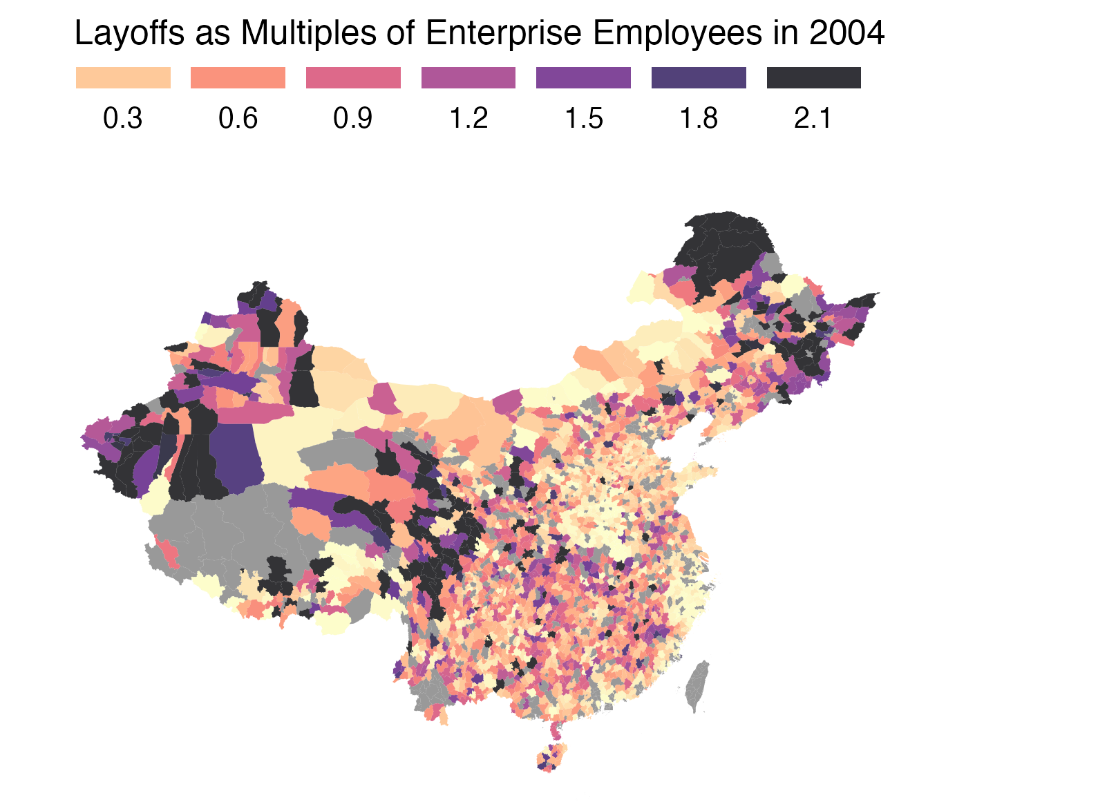
SOE Layoffs
Geographical illustration of total SOE layoffs (1998-2003) denoted as multiples of total employee in 2004
Heavy concentration in the Northeast and the West
Notes:
Here is a geographical illustration of SOE layoffs. We see the northeast and the west are heavily impacted by the SOE layoffs. Those western regions are also regions where the third-front projects moved to.

Slide 22
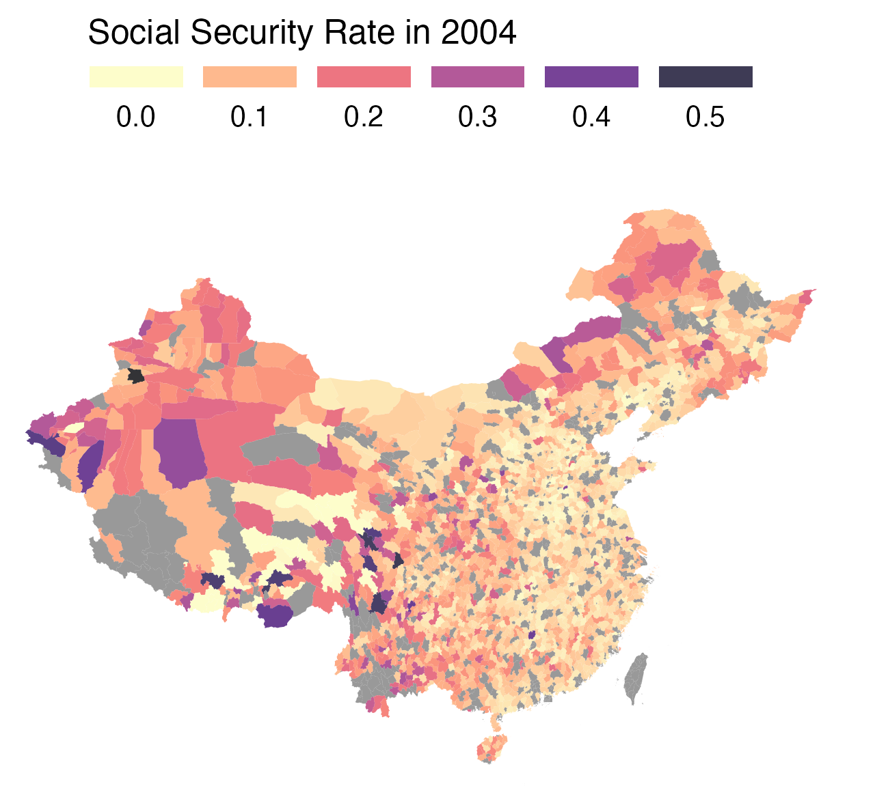
Social Security
Geographical illustration of effective social security rate in 2004
Higher rates in the Northeast and the West
Notes:
Here is the effective social security rates across China. Similar geographical patterns as the SOE layoffs.

Slide 23
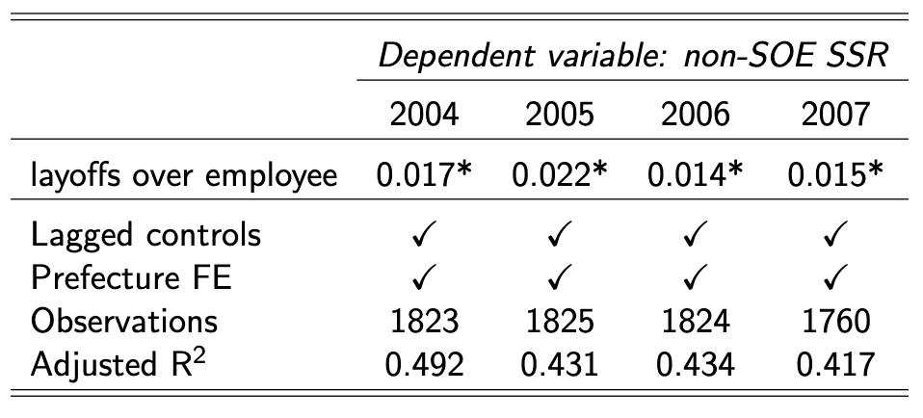
OLS Estimation
Laid-off workers as a share of total employees associated with higher non-SOE social security rate
Notes:
Here is a cross-sectional OLS estimation between layoffs and social security taxes on non-SOEs. Laid-off workers as a share of total employees associated with higher non-SOE social security rate across all years in data

Slide 24
Instrumental Variable
Threat to inference: scale of layoffs not randomly assigned
Instrument: Number of employees working in SOEs founded between 1964–1972 (“Third Front” era) in 1998
Sino-Soviet Split and the US hostility prompted Mao to relocate industries to inlands
Notes:
In assessing the impact of layoffs on social security rates, a key threat to inference is that the scale of layoffs was not randomly assigned.
To address this, I used an instrumental variable with the number of employees working in SOEs founded during the "Third Front" era (1964–1972). This period is significant because Mao Zedong prioritized strategic concerns in industrial investment due to fears of invasion from both Soviet and the US, a priority that was mitigated only after the China-US rapprochement in 1972.

Slide 25
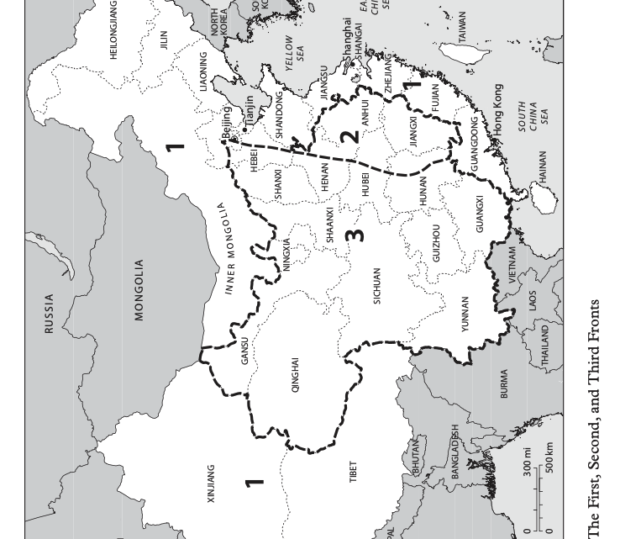
Third-Front Construction
Big Third Front: 13 provinces in the West, e.g. Panzhihua, Sichuan
Small Third Front: remote areas in First Front, e.g. Acheng near Harbin
“Near mountains, spread out, take cover”
(Meyskens, 2020)
Notes:
The "Big Third Front" encompassed extensive industrial development projects spread across 13 provinces in Western China, including cities like Panzhihua in Sichuan. Conversely, the "Small Third Front" referred to similar but smaller-scale initiatives that took place in more remote areas within provinces that were already part of the economically developed Eastern or "First Front." An example of this is Acheng, located near Harbin. The guiding principle for both the Big and Small Third Fronts was to "near mountains, spread out, take cover," reflecting a strategic emphasis on geographic seclusion.

Slide 26
Instrumental Variable Criteria
Relevance: Due to lack of economic rationale, third-front SOEs bankrupt after 1998 and workers laid-off
Exclusion restriction: strategic concerns of the Mao era influenced the initial investment and subsequent fate of these SOEs but not social security collection in 2000s independently
Social Security from non-SOE
Third-front SOE ➔ Laid-off workers ➔
Notes:
The relevance of the instrument lies in the fact that many third front SOEs, established without a solid economic rationale and surviving primarily due to state support, went bankrupt post-1998, resulting in massive layoffs.
The exclusion restriction is based on the premise that the strategic concerns of the Mao era influenced the initial investment and subsequent fate of these SOEs but not social security collection independently.. Frankly, there was no existence of private economy or social security system in that era.

Slide 27
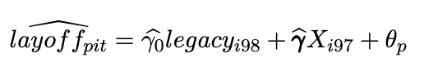
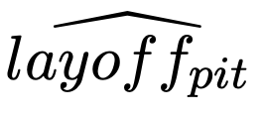
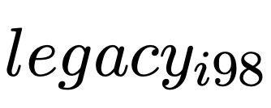
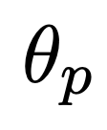
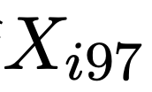
2SLS Model: First Stage
: the instrumented layoff size of SOE employees 1998-2003 of county i
: the instrumental variable of state employees in legacy Third-Front SOEs in 1998
: prefecture fixed effects
: control variables of county i in 1997
Notes:
This is the first stage model for instrumental variable regression.

Slide 28
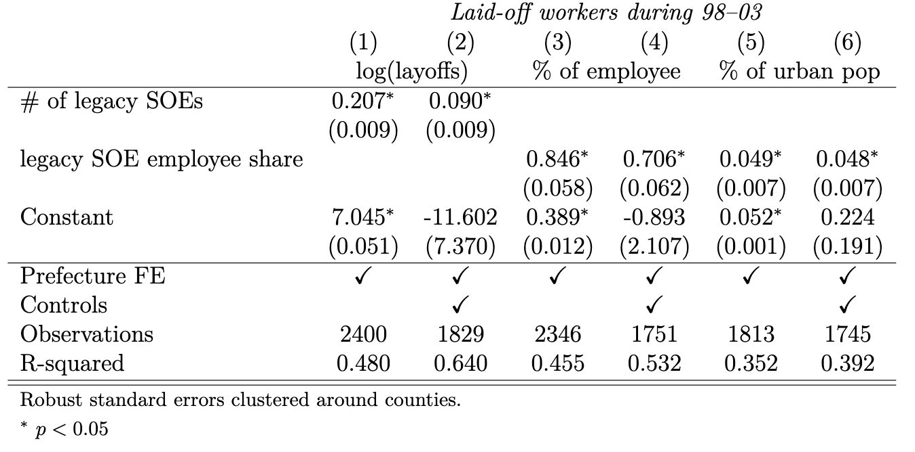
2SLS Model: First Stage
Notes:
This is the first stage of the instrument variable estimation. Legacy SOEs presence strongly correlate with later SOE layoffs.
The effect is not only significant but very substantive. Looking at model 3, 10 percent increase third front SOE employees share is correlated with 8 percent increase in laid-off employee share in later years.

Slide 29
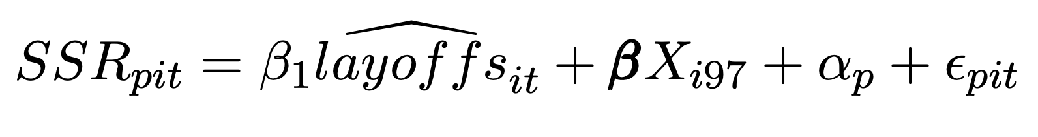
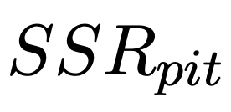
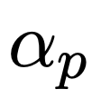
2SLS Model: Second Stage
: social security rate for county i in prefecture p in year t
: prefecture fixed effects
Notes:
Then we use the predicted values of layoffs to regress with social security collection rates.

Slide 30
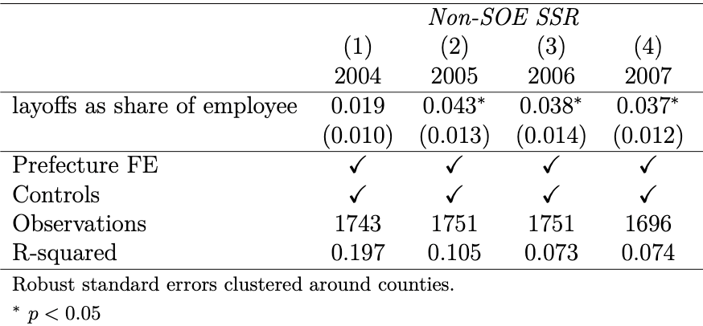
2SLS Model: Second Stage
For a median county in 2005, layoffs explain a 2.4 percentage point increase in non-SOE SSR, 46% of the average SSR level among the non-SOEs in 2005 (5.2%).
Notes:
For a median county in 2005, layoffs explains a 2.4 percentage point increase in non-SOE SSR, which accounts for 46% of the average SSR level among the non-SOEs in 2005 at 5.2 percentage point.

Slide 31
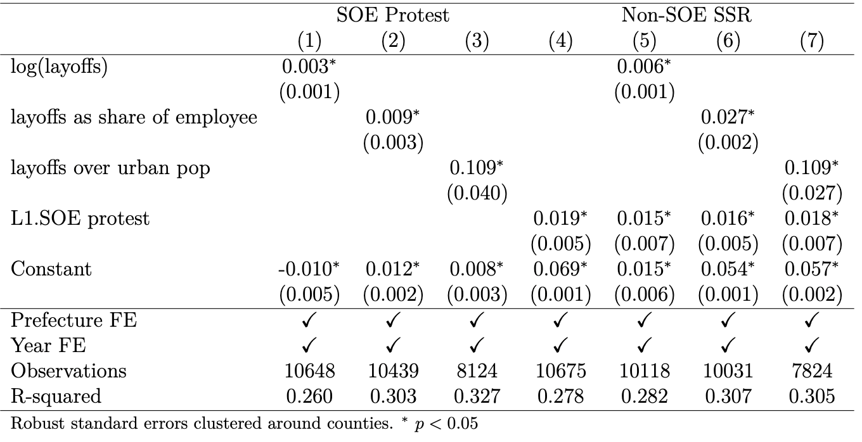
Mechanism
Model (1-3) Layoffs are consistently correlated with more SOE protests
Model (4) Past SOE protest predicts higher social security collection among non-SOE
Model (5-7) Both realized and potential collective action matter
Notes:
I claim that expected collective action as the mechanism. I do find that layoffs are consistently correlated with more SOE protests. In model 1-3, we see irrespective how you measure layoffs, they strongly correlate with SOE protests.
In model 4, we see past SOE protest correlates with higher social security collection. Furthermore, past protests are significant alongside layoffs. This imply that both realized and potential collective action play a crucial role in compelling local states to increase redistribution.

Slide 32
Implications
1. Link between SOE layoffs and increased social security collection on non-SOEs
2. Evidence of China’s policy responsiveness in response to protests
3. Inadequacy of “threat-driven” welfare expansion
4. Winners (SOEs, investors, non-SOE workers) and losers (laid-off workers, non-SOE firms) in China's SOE reform
Notes:
The study establishes a connection between the layoffs in SOEs and the subsequent increase in social security collections from non-state enterprises, pointing to that potential collective action acted as the driver of local state’s redistribution.
It also shows the inherent limitations of China’s redistribution that is driven by threat, as this approach is only intending to keep social unrest at bay instead of decreasing inequality per se.
The analysis also identifies the true beneficiaries and victims by SOE reforms in China. SOEs and their investors and owners, are winners as they are free from welfare burdens and unproductive labors. Their valuations later became so high that SOEs are the most valuable assets of some local governments. non-SOE workers also won because the once-exclusive welfare system opened up for them to join and their employers are compelled to pay for their future welfare. Meanwhile, laid-off workers were the major victims who lost guaranteed employment and lifetime care. But the unknown losers of SOE reform seem to be non-SOE entrepreneurs beared the costs for having to contribute to the social security payments that are used to compensate laid-off workers and SOE retirees.

Slide 33
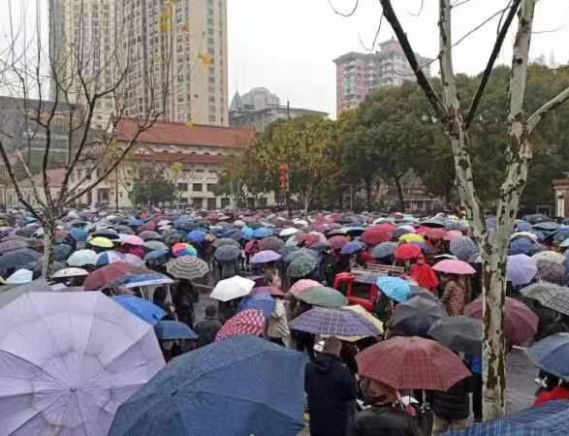
Echo
2023 February, thousands of pensioners protested in front of Wuhan government for the healthcare reform that cut personal account subsidy
The reform was meant to increase coverage of social account and weaken personal account
Wuhan government had to concede
Loss aversion among the population put a significant constraint on governments from reneging welfare promises
Notes:
2023 February, thousands of pensioners protested in front of Wuhan government for the healthcare reform that cut personal account subsidy from 286 to 83 per month.
The reform was meant to increase coverage of social account and weaken personal account
Loss aversion among the population put a significant pressure on governments’ from walking back their welfare promises.
This example shows the welfare promise is imposing a hard constraint on the government to continue redistribution.

Slide 34
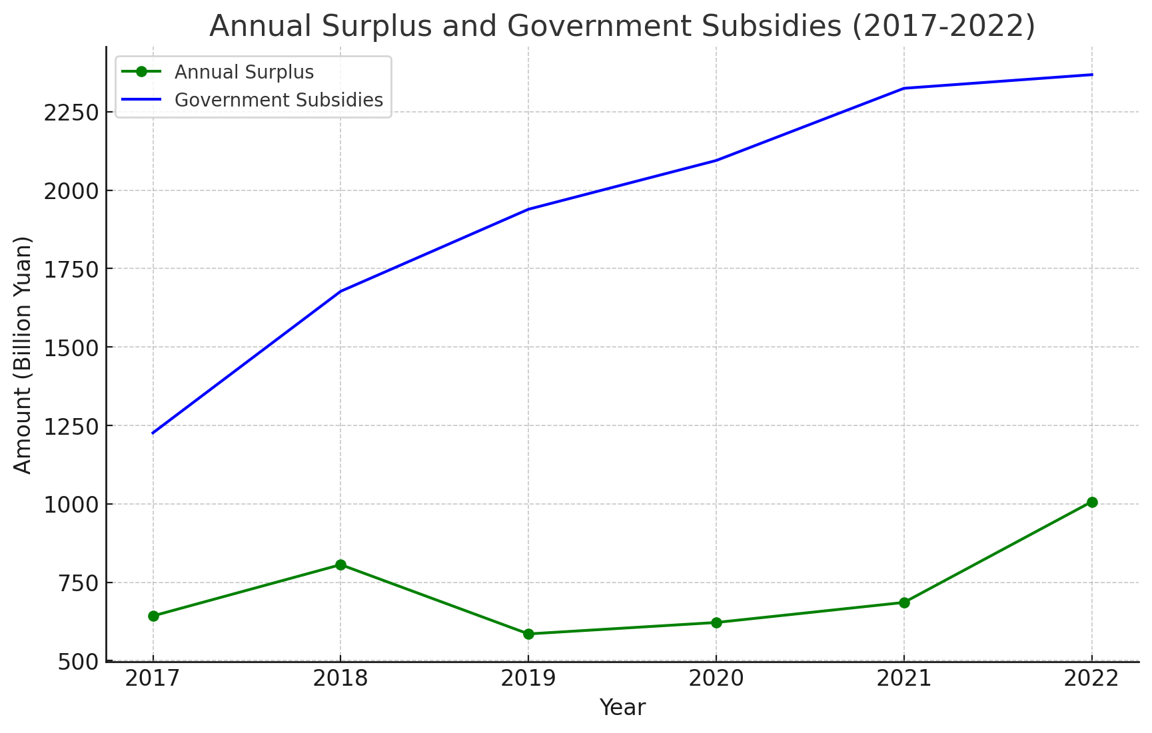
Social Security Fund and Subsidies
Notes:
Not just promises. The threat-driven appeasement also implies that the government would not easily let social security fund to have payment crisis. They are already putting discretionary revenue into social security funds in the case of deficits. Government subsidies reach 2.3 trillion yuan in 2022 and it was the only reason social security reported a surplus.

Slide 35
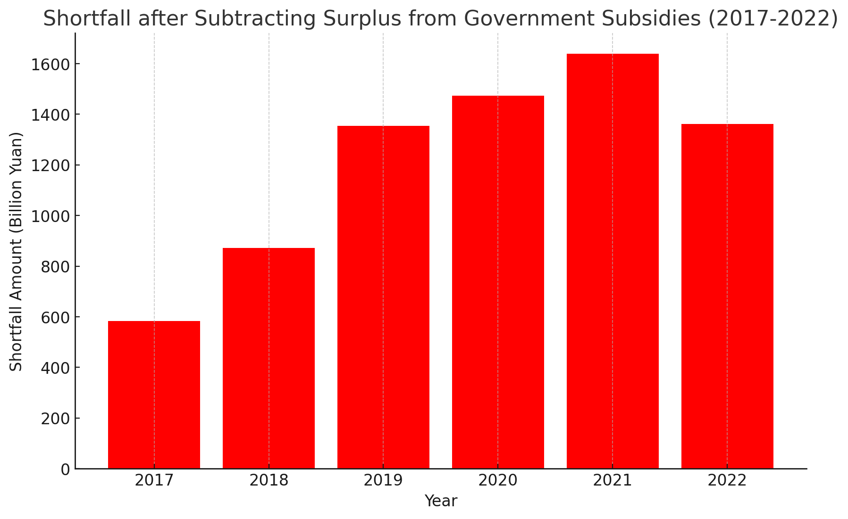
Rising Deficits
Notes:
If you take the gap between the subsidy and the surplus you get a figure of deficit, a rather rapid increase.

Slide 36
Silver Lining of Rebalance
1998 SOE reform
Notes:
Therefore, applying our theoretical implication to this scenario, we should expect China to mechanically increase its social spending as the unfunded entitlements demand more funding from the government as the past contributors now become claimants with the snowballing of welfare state.
This provides a silver lining for the prospect of China’s economic rebalance. The sheer demand of new claimants of the expanded social security system and aging population would require the government to spend much more on social welfare and redistribution which will force the government shift from investment-oriented to consumption-oriented.

Slide 37
Research Pipeline
China’s local governments and political economy
Welfare (forthcoming at SCID)
Public health (R&R at Political Behavior)
Conceptual framework (R&R at CPSR)
Law enforcement (under review)
Propaganda (under review)

Slide 38

Thank You!

Slide 39

Future Research
Why do we observe not only widening coverage but also rising benefits in China’s social security system?
What would be the implications of a centralizing welfare state?
New participation will be exhausted and fiscal resources are finite, what trade off the state is making to balance social stability and fiscal sustainability?

Slide 40
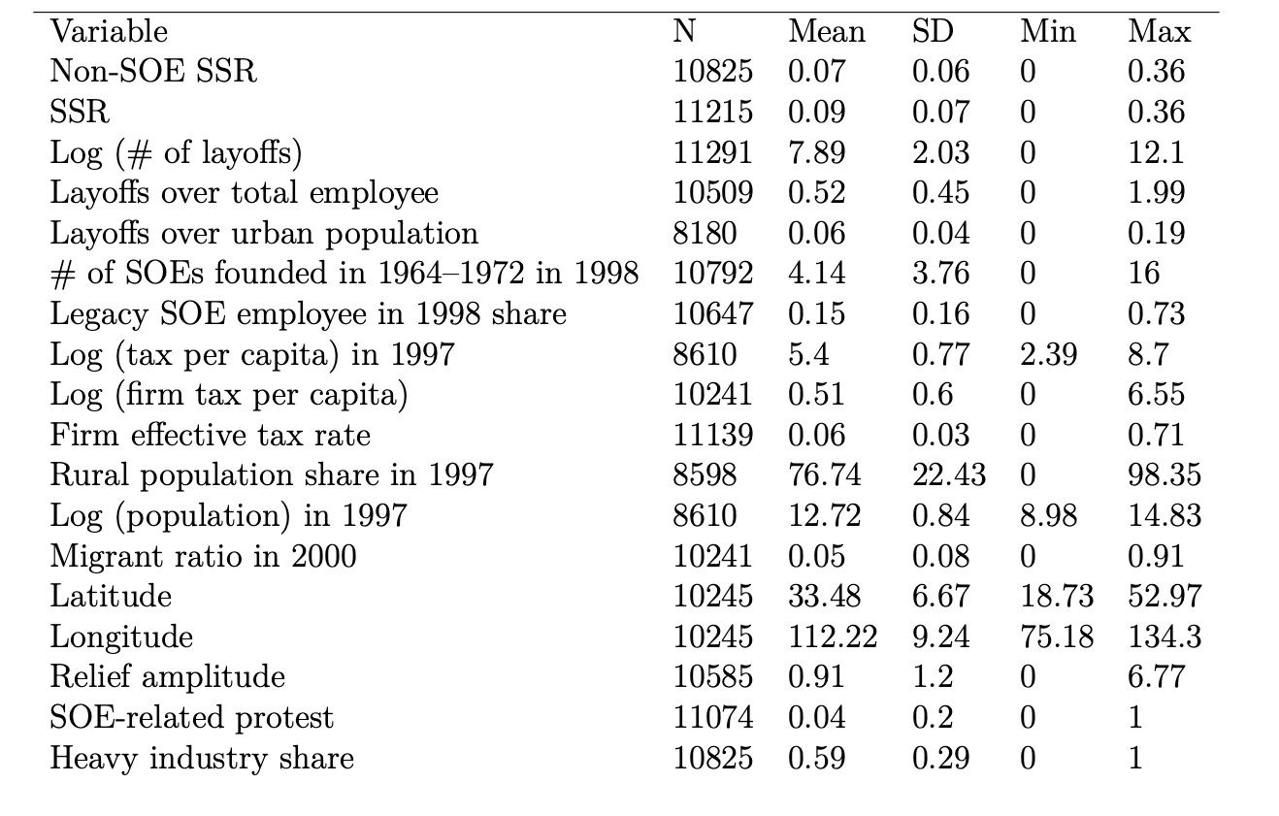
Summary Statistics

Slide 41
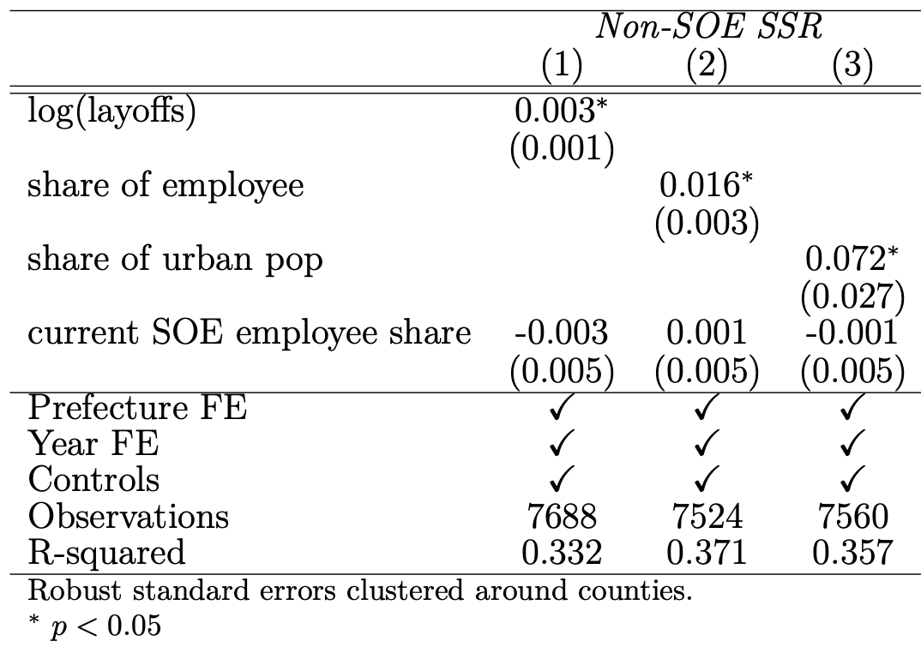
Robustness Check

Slide 42
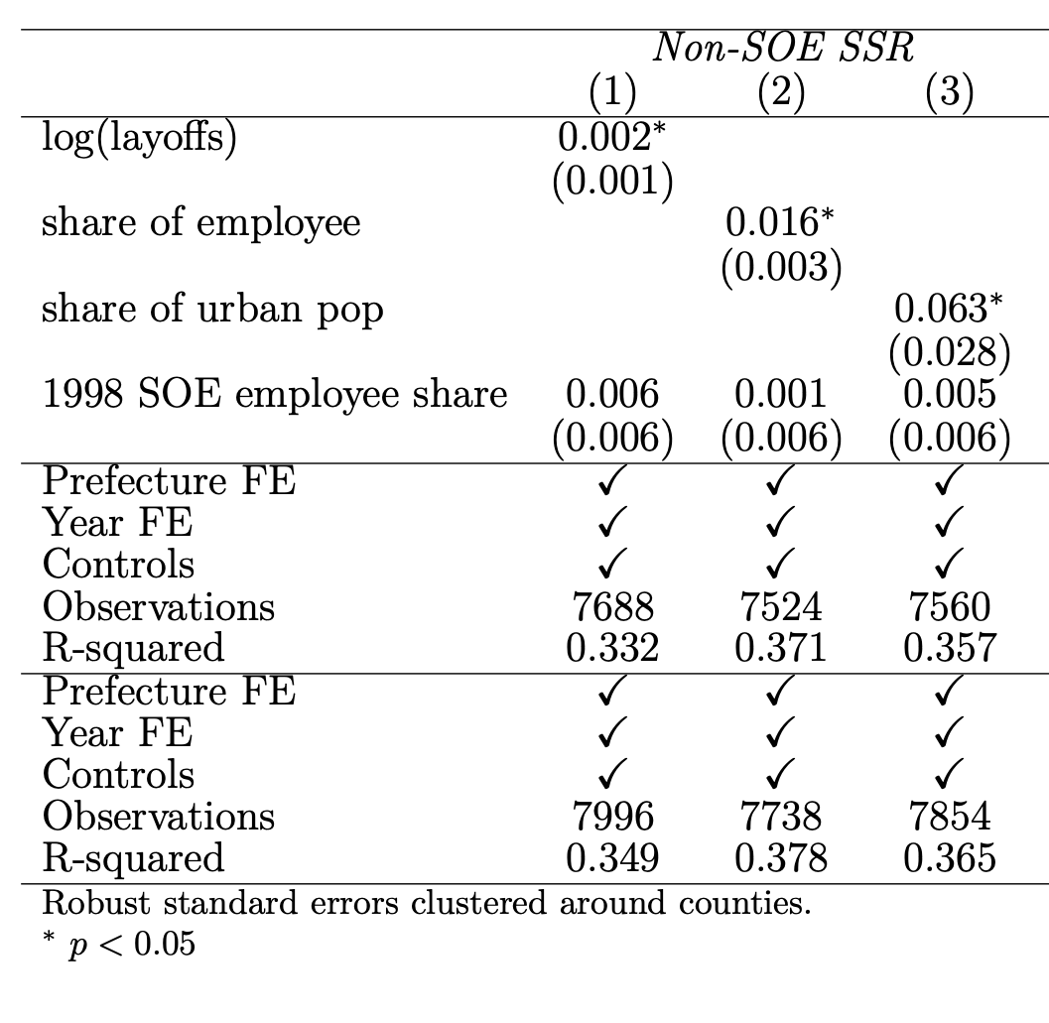
Robustness Check

Slide 43
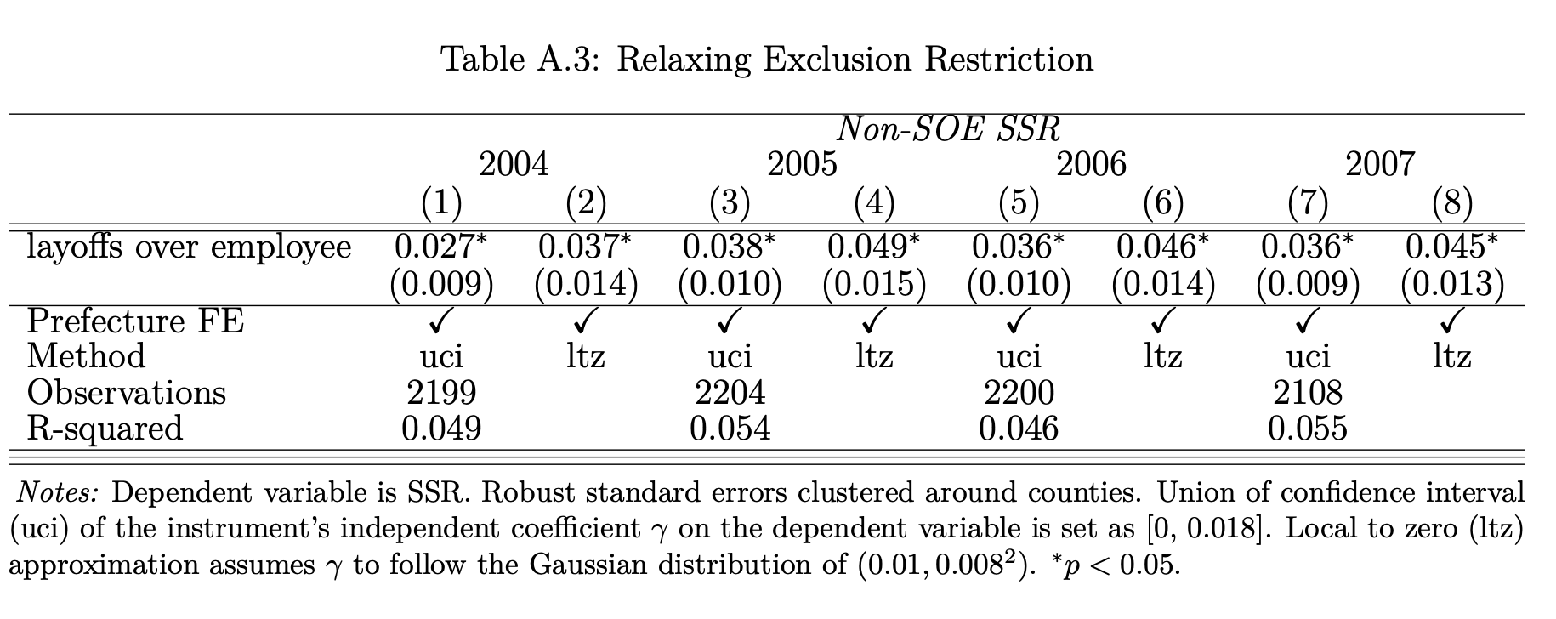
Robustness Check

Slide 44
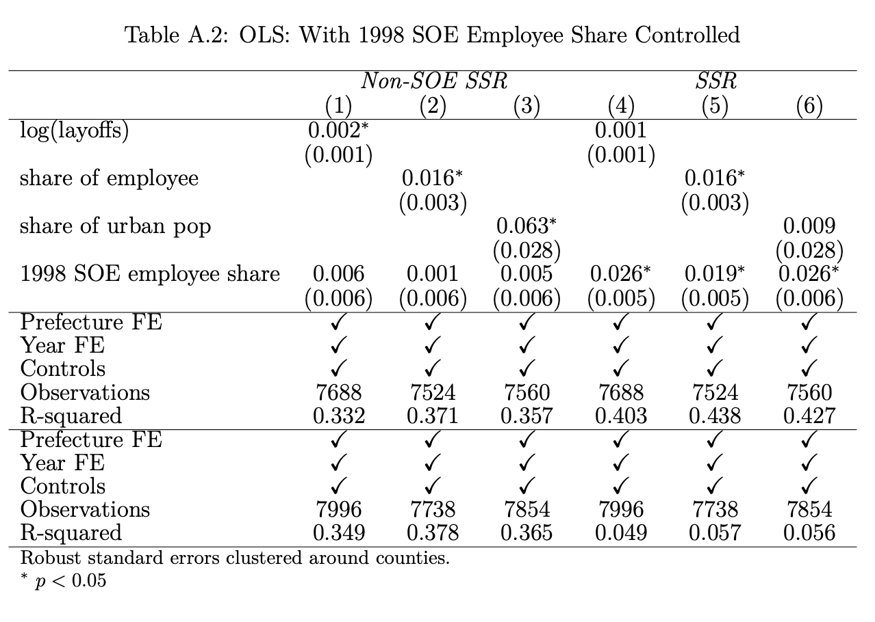

Slide 45
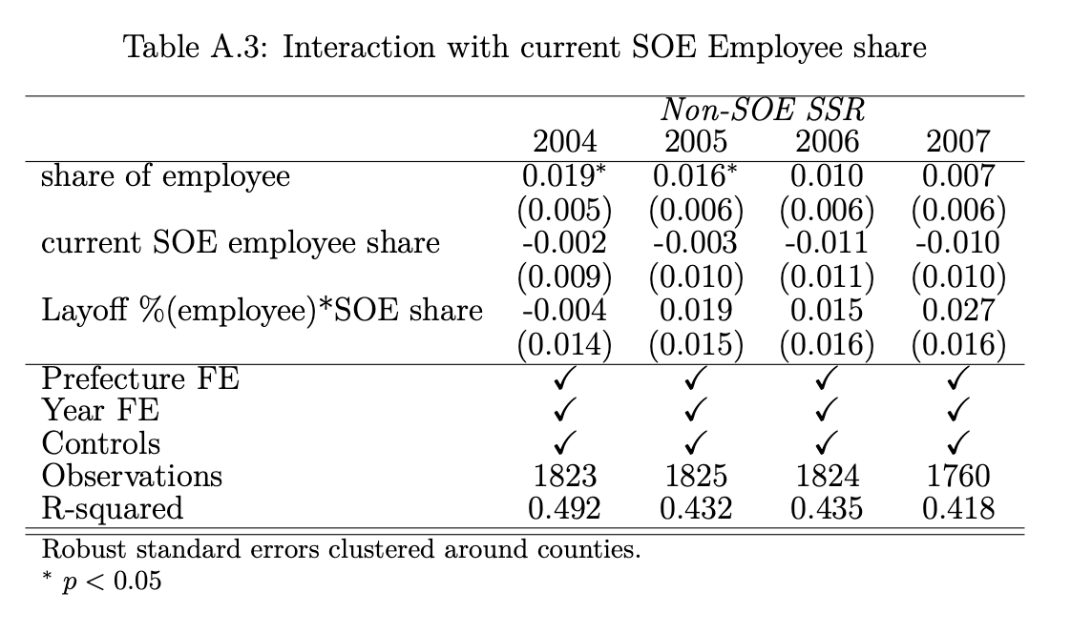

Slide 46
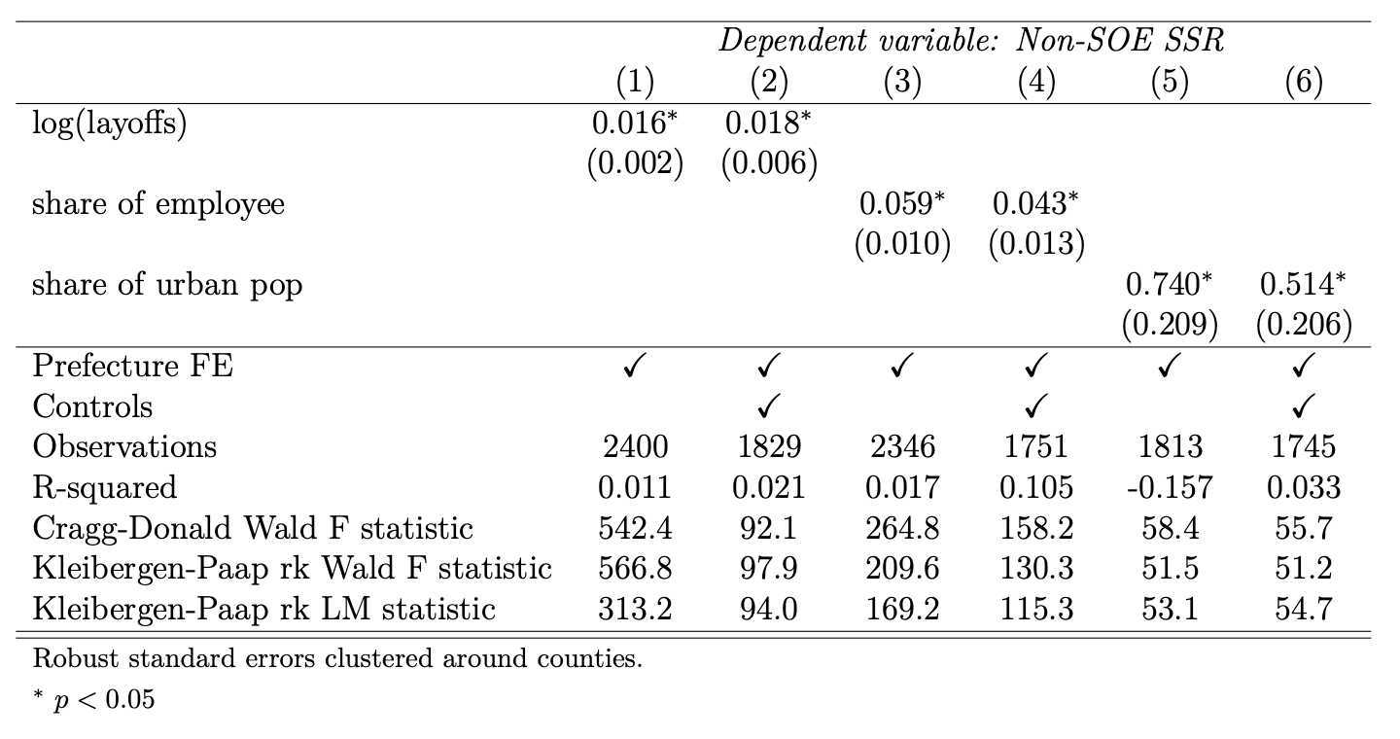
2SLS Second Stage: non-SOE SSR (2005)

Slide 47
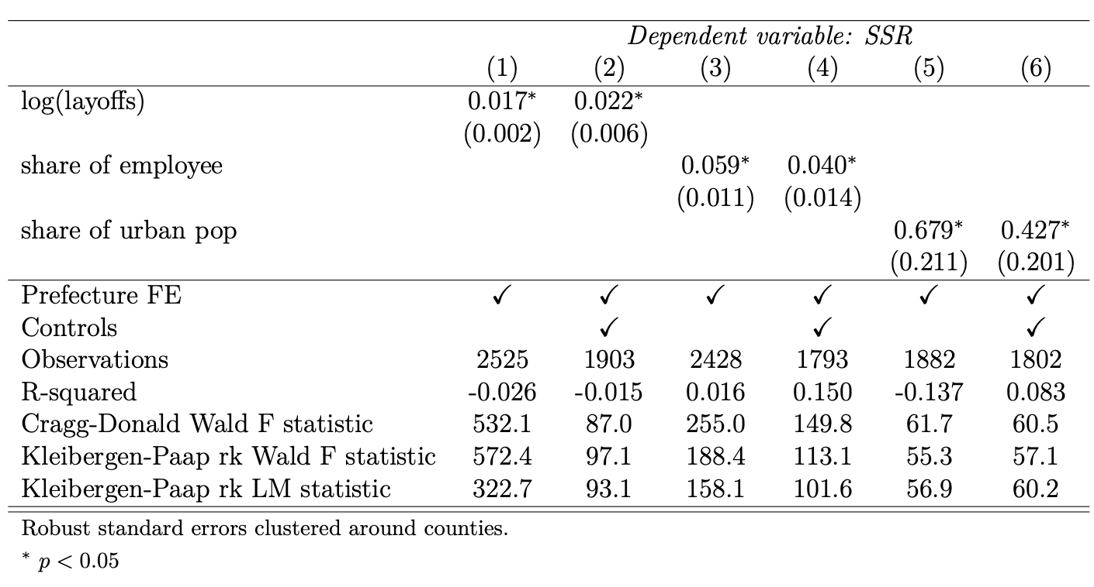
2SLS Second Stage: SSR (2005)

Slide 48
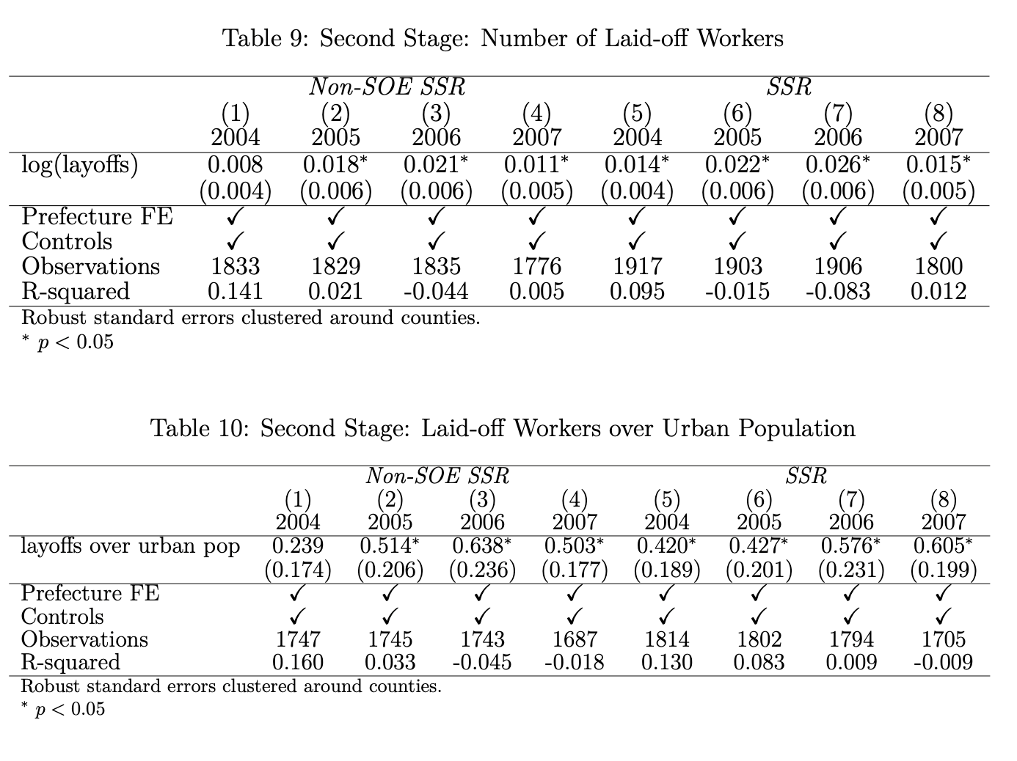

Slide 49


Slide 50
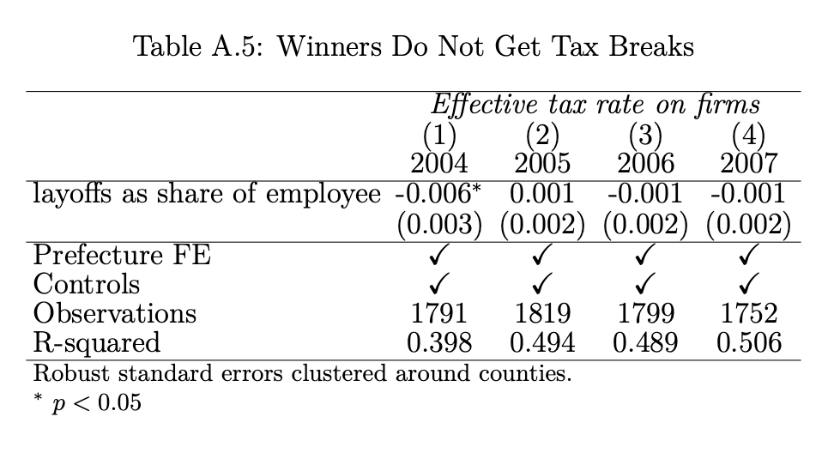
Redistribution, not Rechanneling

Slide 51
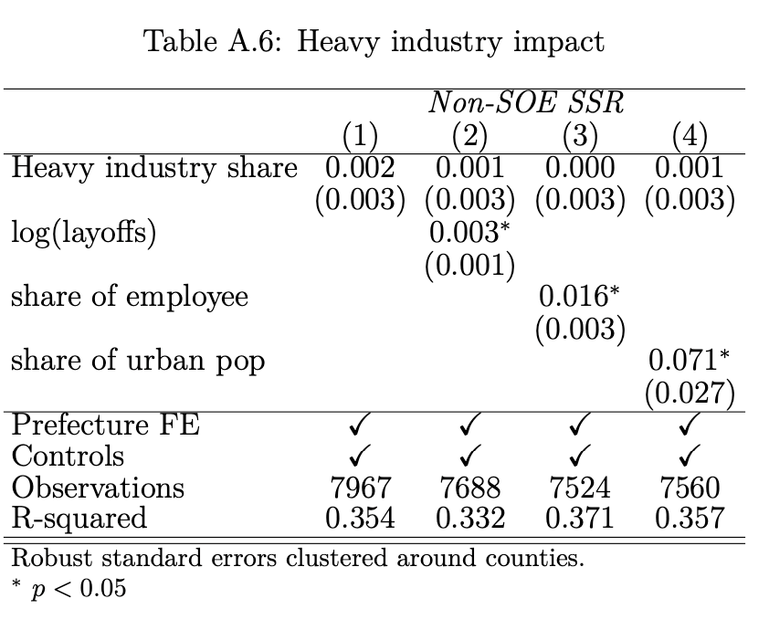

Slide 52
Exclusion restriction
Time frame determined exogenously by US bombing of North Vietnam in 1964 and Nixon visit of China in 1972
No private economy or social security system in that period
Investment decision made for diversification reason: Mao commanded be “near mountains, spread out, take cover”
Resource landscape and infrastructure landscape changed dramatically

Slide 53
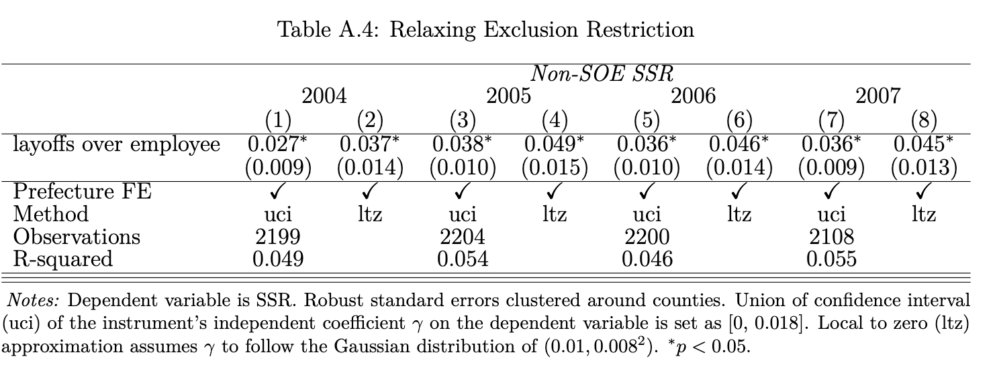

Slide 54
